Slide 1
How to create a popular song
Pavel Raschetnov & Rishab Bhattacharyya

Slide 2

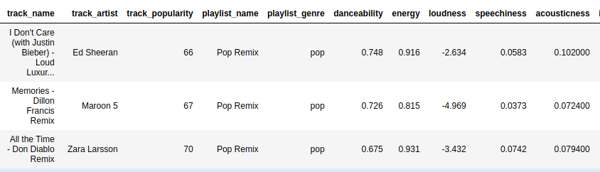
Spotify songs dataset
28k unique songs
10k artists
Special audio features calculated by spotify

Slide 3

Spotify songs dataset
Does a track popularity depend on these features??
28k unique songs
10k artists
Special audio features calculated by spotify

Slide 4
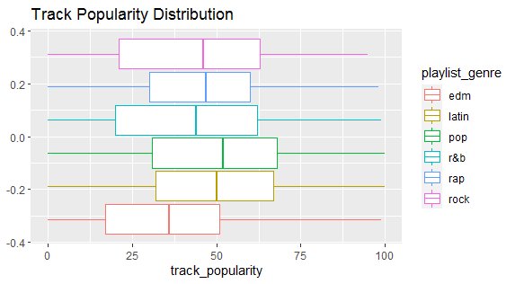
How popularity is distributed
Track Popularity Distribution shows the overall distribution of track popularity over different genres. It may be interesting to note that pop music has the highest track popularity, while EDM music tracks are the least popular.

Slide 5
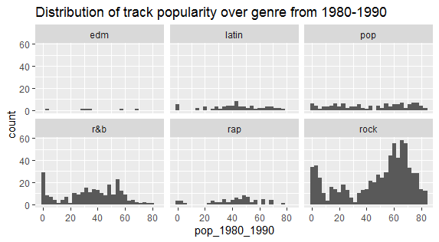
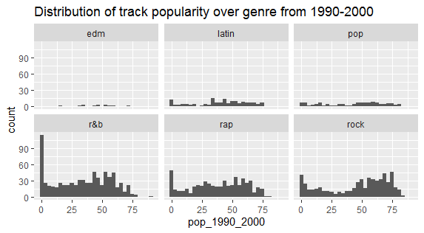
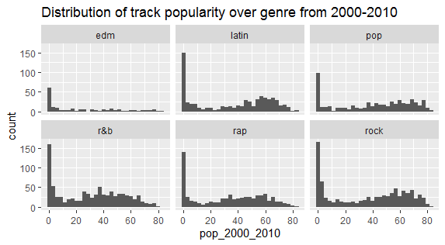
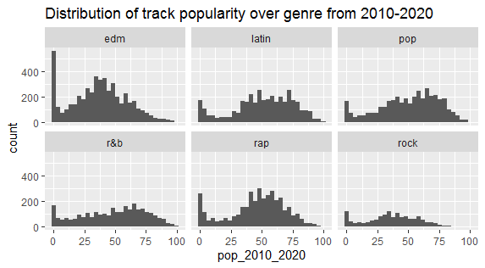
Distribution of track popularity in the last 4 decades

Slide 6
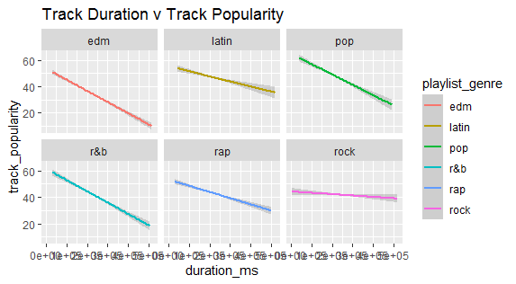
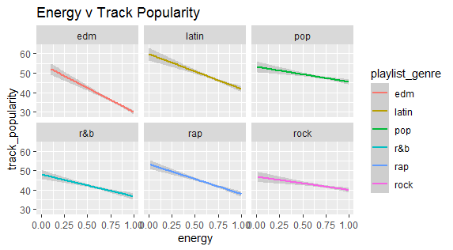
How features like track duration,energy depend on popularity

Slide 7
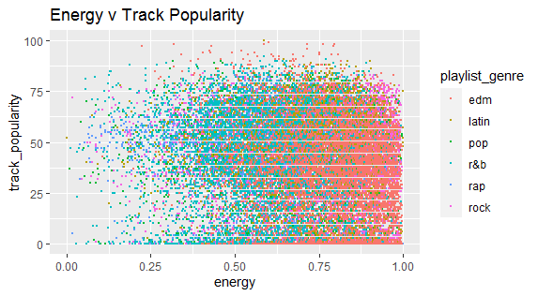
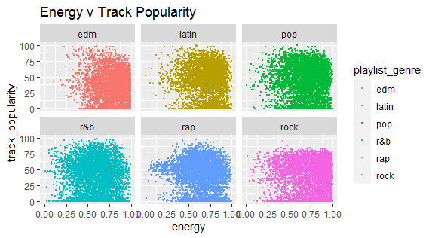
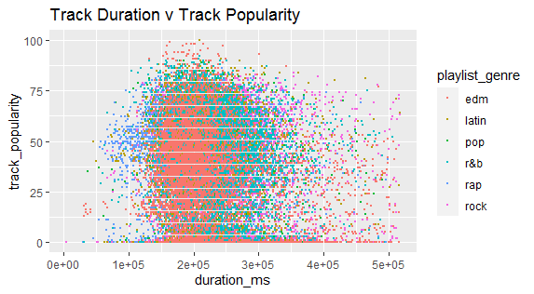
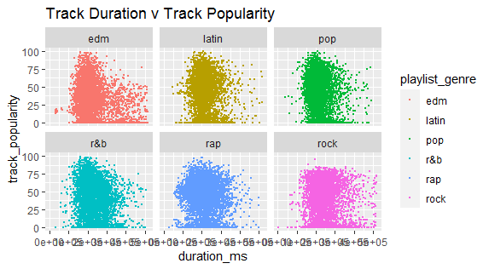
Now let us look at some scatterplots

Slide 8
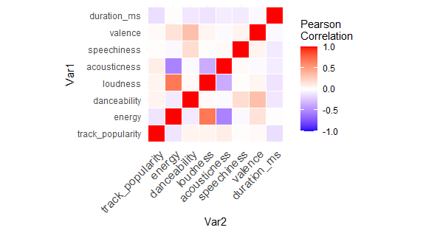
Hypothesis 1: track popularity has correlation with some special features

Slide 9
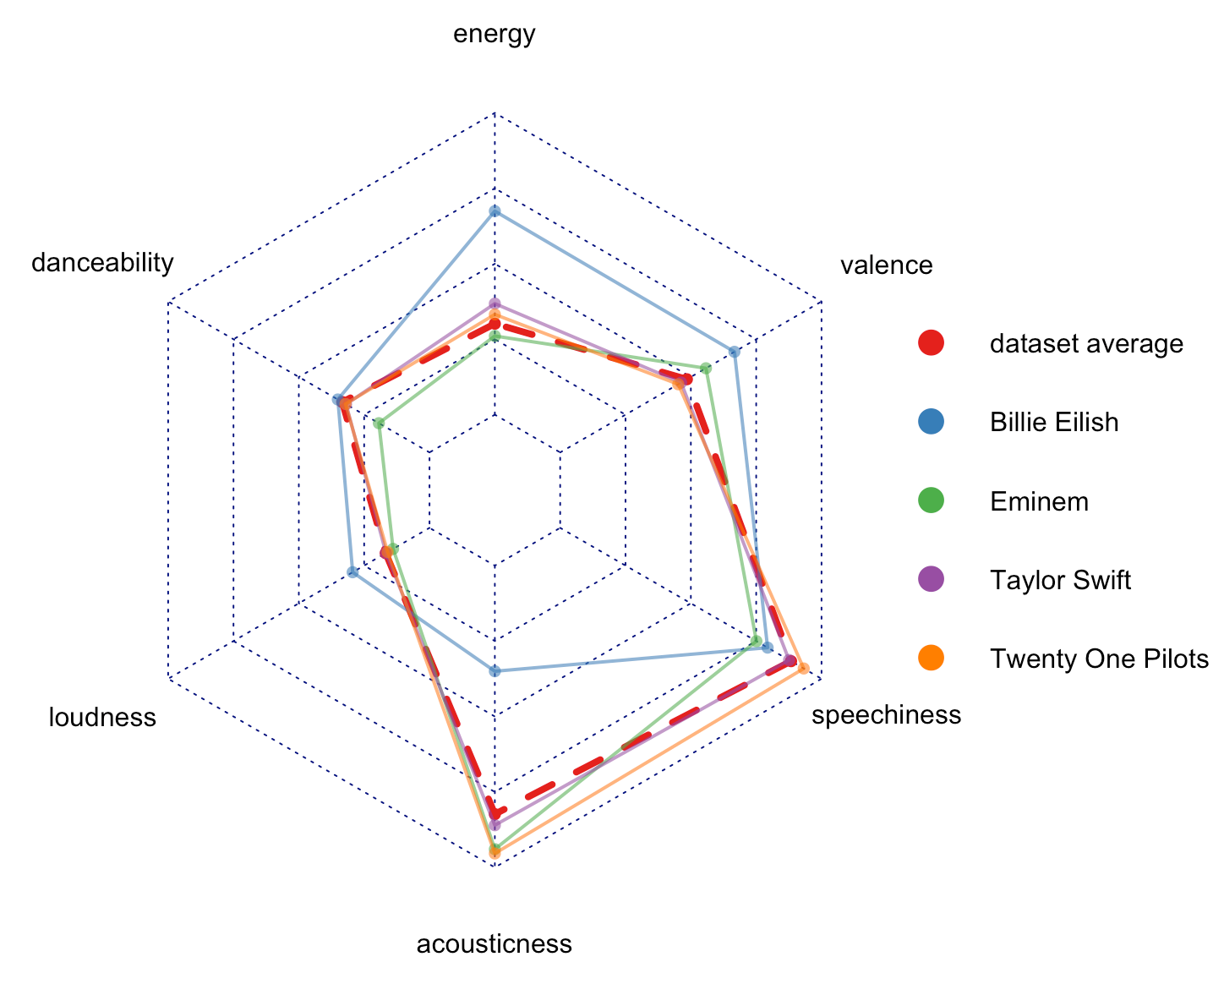
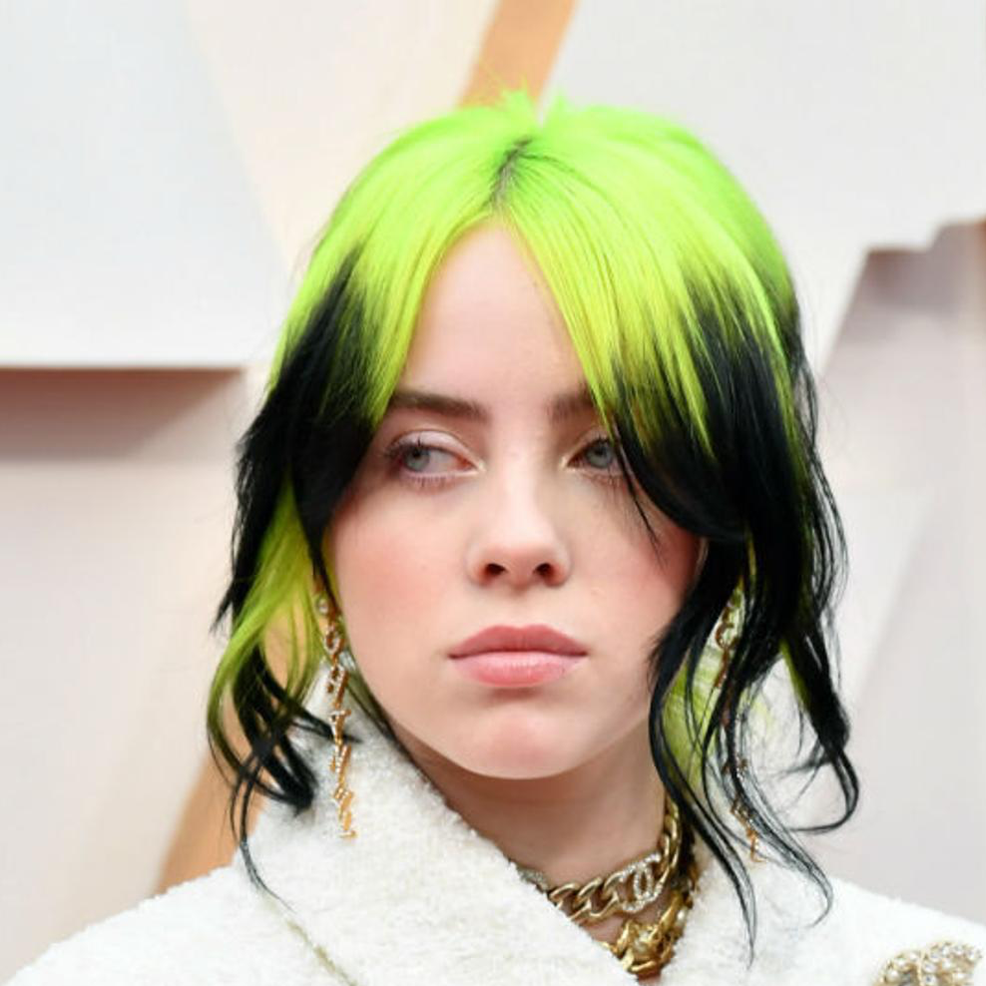
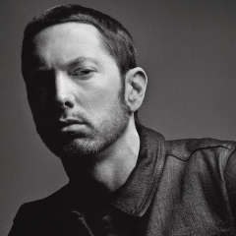
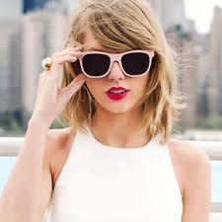
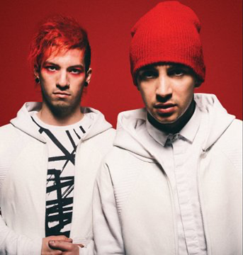
Hypothesis 2: Popular songs have much different feature values than the average
Idea: take most popular artists:
Billie Eilish
Eminem
Taylor Swift
Twenty One Pilots
Compare features of their top 15 songs
with the average feature values for the dataset

Slide 10
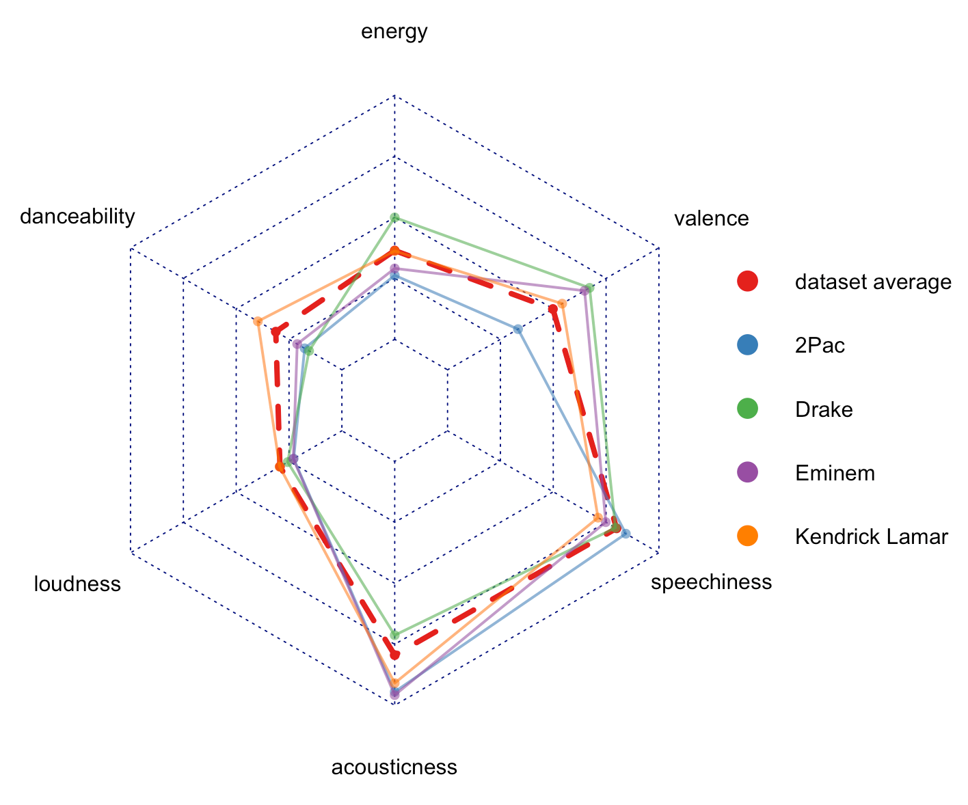
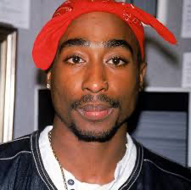


What about a specific genre?
Most popular artists of the “rap” genre:
2Pac
Eminem
Drake
Kendrick Lamar
Their tracks don’t exhibit
extraordinary track features

Slide 11
Fitting a linear model
track_popularity ~ energy+danceability+loudness+ … +speechiness+valence+duration_ms
R-squared: 0.04874
Only ~5% of of the variance found in the response variable (track_popularity) can be explained by the predictor variables

Slide 12
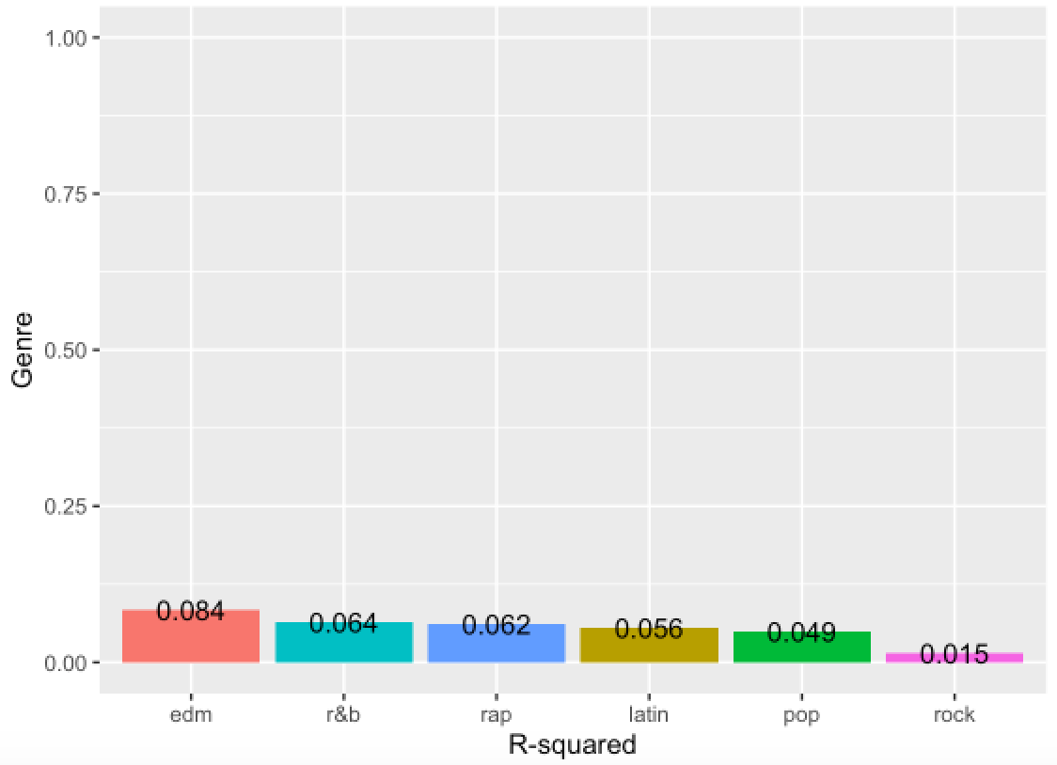
Fitting a linear model
track_popularity ~ energy+danceability+loudness+ … +speechiness+valence+duration_ms
R-squared: 0.04874
Only ~5% of of the variance found in the response variable (track_popularity) can be explained by the predictor variables
Fitting a linear model separately for
different genres:

Slide 13
Conclusion
Song popularity in spotify doesn’t depend on any particular musical features
Most artists create tracks that have feature values close to the mean
Other factors must have higher impact on song popularity, such as release date, album success, lyrics, marketing…

Slide 14
Conclusion
Song popularity in spotify doesn’t depend on any particular musical features
Most artists create tracks that have feature values close to the mean
Other factors must have higher impact on song popularity, such as release date, album success, lyrics, marketing…
! Billie Eilish is the most popular artist as of January 2020

